Slide 1
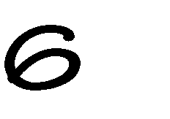

Slide 2
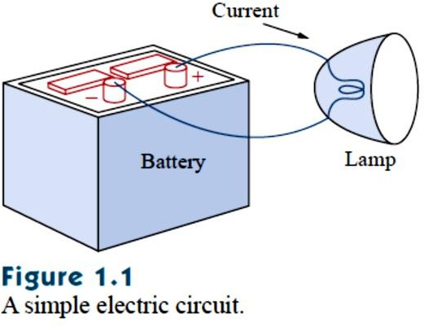
1-1 Introduction
Electric circuit theory and electromagnetic theory are the two fundamental theories upon which all branches of electrical engineering
are built. Many branches of electrical engineering, such as power, electric machines, control, electronics, communications, and instrumentation, are based on electric circuit theory. Therefore, the basic electric circuit theory course is the most important course for an electrical engineering student,
and always an excellent starting point for a beginning student in electrical engineering education. Circuit theory is also valuable to students
specializing in other branches of the physical sciences because circuits are a good model for the study of energy systems in general, and because
of the applied mathematics, physics, and topology involved.
In electrical engineering, we are often interested in communicating or transferring energy from one point to another. To do this requires an interconnection of electrical devices. Such interconnection is referred to as an electric circuit, and each component of the circuit is known as an
element.
An electric circuit is an interconnection of electrical elements.
A simple electric circuit is shown in Fig. 1.1. It consists of three basic elements: a battery, a lamp, and connecting wires. Such a simple circuit can exist by itself; it has several applications, such as a flashlight, a search light, and so forth.

Slide 3
Our goal in this text is to learn various analytical techniques and computer software applications for describing the behavior of a circuit like this.
Electric circuits are used in numerous electrical systems to accomplish different tasks. Our objective in this book is not the study of various uses and applications of circuits. Rather our major concern is the analysis of the circuits. By the analysis of a circuit, we mean a study of the behavior of the circuit: How does it respond to a given input? How do the interconnected elements and devices in the circuit interact?
We commence our study by defining some basic concepts. These concepts include charge, current, voltage, circuit elements, power, and
energy. Before defining these concepts, we must first establish a system of units that we will use throughout the text.
1-2 System of Units
As electrical engineers, we deal with measurable quantities. Our measurement, however, must be communicated in a standard language
that virtually all professionals can understand, irrespective of the country
where the measurement is conducted. Such an international measurement language is the International System of Units (SI), adopted by the General Conference on Weights and Measures in 1960. In this system, there are
six principal units from which the units of all other physical quantities can be derived. Table 1.1 shows the six units, their symbols, and the physical quantities they represent. The SI units are used throughout this text.
One great advantage of the SI unit is that it uses prefixes based on the power of 10 to relate larger and smaller units to the basic unit. Table 1.2 shows the SI prefixes and their symbols. For example, the following are expressions of the same distance in meters (m):
600,000,000 mm 600,000 m 600 km

Slide 4
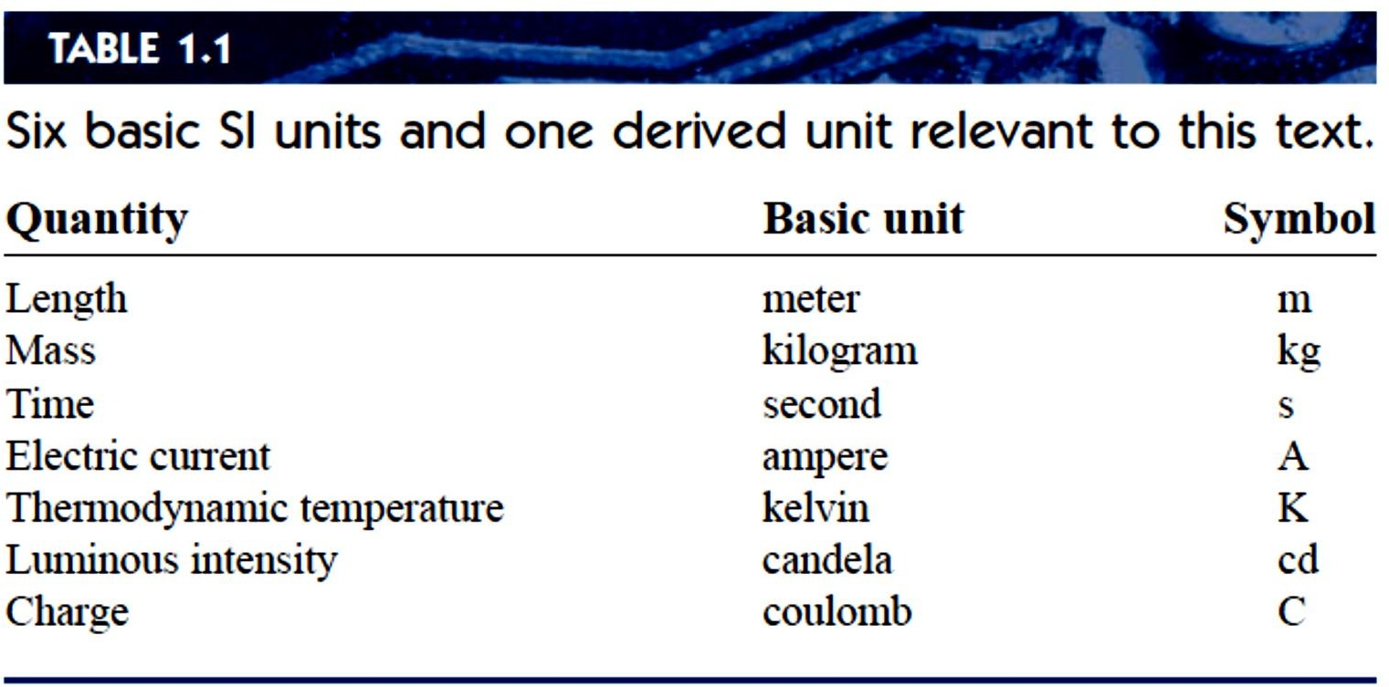
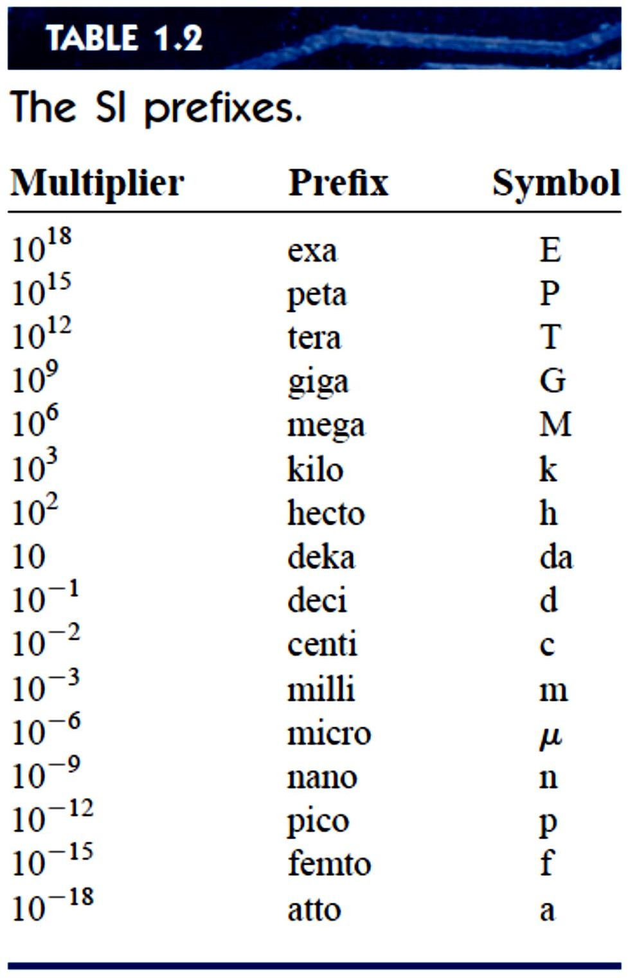

Slide 5
1-3 Charge and Current
The concept of electric charge is the underlying principle for explaining all electrical phenomena. Also, the most basic quantity in an electric
circuit is the electric charge. We all experience the effect of electric charge when we try to remove our wool sweater and have it stick to our body or walk across a carpet and receive a shock.
Charge is an electrical property of the atomic particles of which matter
consists, measured in coulombs (C).
We know from elementary physics that all matter is made of fundamental building blocks known as atoms and that each atom consists of electrons, protons, and neutrons. We also know that the charge e on an electron is negative and equal in magnitude to 1.602 × 10⁻¹⁹𝐶, while a proton carries a positive charge of the same magnitude as the electron. The presence of equal numbers of protons and electrons leaves an atom neutrally charged.
The following points should be noted about electric charge:
1. The coulomb is a large unit for charges. In 1 C of charge, there are
1
= 6.24 × 10¹⁸ electrons. Thus realistic or laboratory values of
1.602×10⁻¹⁹
charges are on the order of 𝑝𝐶, 𝑛𝐶 𝑜𝑟 𝜇𝐶.
According to experimental observations, the only charges that occur in nature are integral multiples of the electronic charge −1.602 × 10¹⁹C.
The law of conservation of charge states that charge can neither be
created nor destroyed only transferred. Thus the algebraic sum of the electric charges in a system does not change.
When a conducting wire (consisting of several atoms) is connected to a battery (a source of electromotive force), the charges are compelled to
move; positive charges move in one direction while negative charges

Slide 6
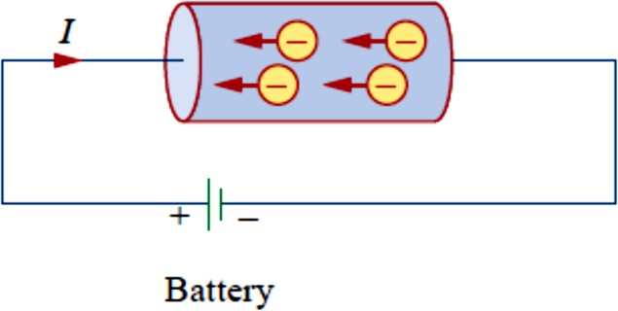
move in the opposite direction. This motion of charges creates electric current. It is conventional to take the current flow as the movement of positive charges. That is, opposite to the flow of negative charges, as Fig.
1.2 illustrates. This convention was introduced by Benjamin Franklin (1706–1790), the American scientist and inventor. Although we now know that current in metallic conductors is due to negatively charged electrons, we will follow the universally accepted convention that current is the net flow of positive charges. Thus,
Electric current is the time rate of change of charge, measured in amperes (A).
Fig. 1.2 Electric current due to flow of electronic charge in a conductor.
Mathematically, the relationship between current i, charge q, and time t is
𝑑𝑞
𝑖 ≜ _{𝑑𝑡}
Where current is measured in amperes (A), and
1 ampere = 1 coulomb/second
(1.1)
The charge transferred between time 𝑡_{𝑜} and 𝑡 is obtained by integrating both sides of Eq. (1.1). We obtain
𝑡
𝑄 ≜ ∫ 𝑖𝑑𝑡 (1.2)
𝑡𝑜

Slide 7
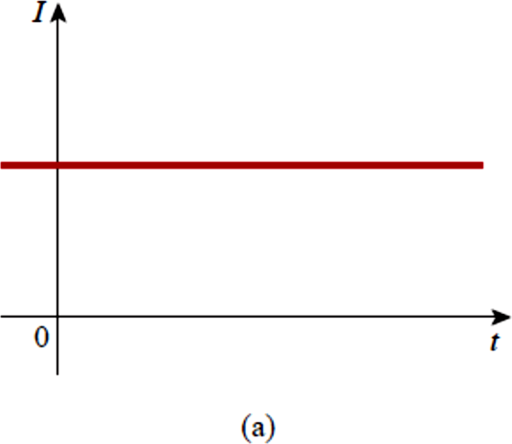
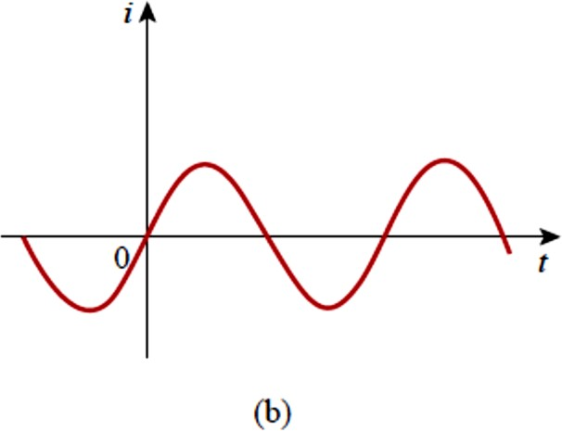
If the current does not change with time, but remains constant, we call it a direct current (dc).
A direct current (dc) is a current that remains constant with time .
By convention the symbol I is used to represent such a constant current. A time-varying current is represented by the symbol i. A common form of time-varying current is the sinusoidal current or alternating current (ac).
An alternating current (ac) is a current that varies sinusoidally with time.
Such current is used in your household, to run the air conditioner, refrigerator, washing machine, and other electric appliances. Figure 1.3 shows direct current and alternating current; these are the two most common types of current. We will consider other types later in the book.
Fig. 1.3 Two common types of current: (a) direct current (dc), (b) alternating current (ac).
Shows direct current and alternating current; these are the two most common types of current.
Once we define current as the movement of charge, we expect current to have an associated direction of flow. As mentioned earlier, the direction
of current flow is conventionally taken as the direction of positive charge

Slide 8
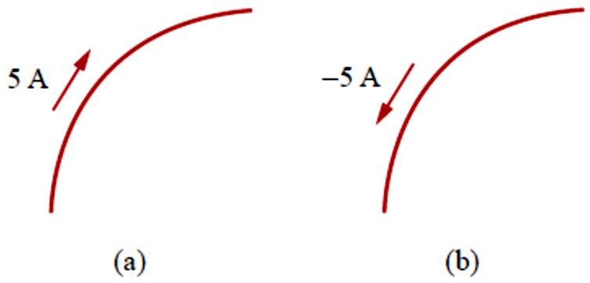
movement. Based on this convention, a current of 5 A may be represented positively or negatively as shown in Fig. 1.4. In other words, a negative current of −5 A flowing in one direction as shown in Fig. 1.4(b) is the same as a current of +5 A flowing in the opposite direction.
Fig. 1.4 Conventional current flow: (a) positive current flow, (b) negative current flow.
Example 1.1
How much charge is represented by 4,600 electrons?
Practice Problem 1.1
Calculate the amount of charge represented by four million protons.

Slide 9
Example 1.2
The total charge entering a terminal is given by Calculate the current at 𝑡 = 0.5 𝑠.
𝑞 = 5𝑡𝑠𝑖𝑛4𝜋𝑡 𝑚𝐶.
Practice Problem 1.2
If in Example 1.2, 𝑞 = (10 − 10𝑒^{−2𝑡} )𝑚𝐶, find the current at 𝑡 = 0.5 𝑠.

Slide 10
Example 1.3
Determine the total charge entering a terminal between 𝑡 = 1 𝑠 and
𝑡 = 2 𝑠 if the current passing the terminal is 𝑖 = (3𝑡² − 𝑡) 𝐴.
Practice Problem 1.3
The current flowing through an element is
2 𝐴
𝑖 = {
2𝑡² 𝐴
0 < 𝑡 < 1
𝑡 > 1
Calculate the charge entering the element from 𝑡 = 0 𝑡𝑜 𝑡 = 2 𝑠.

